Slide 1
Values, beliefs, attitudes and character
Prof. Koliya Pulasinghe

Slide 2
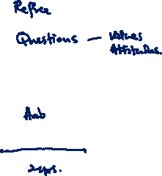
Agenda
Values
Beliefs
Attitudes
Character

Slide 3
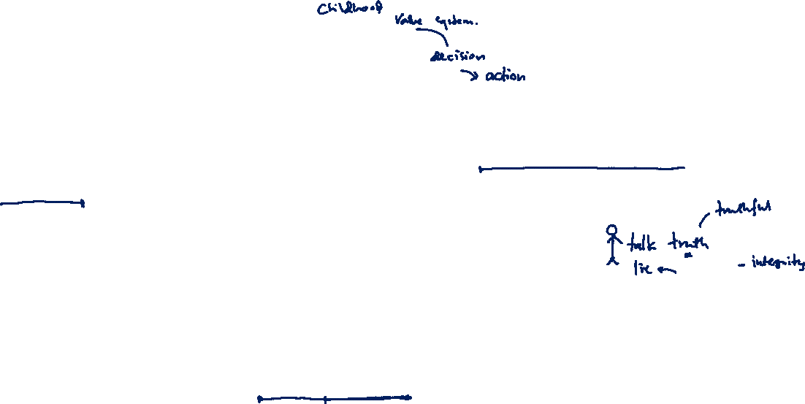
Values: What are they?
The principles that help you to decide what is right and wrong, and how to act in various situations – Oxford Dictionary
The importance of a value system is that once internalized it becomes, consciously or subconsciously, a standard or criterion for guiding one’s action.

Slide 4
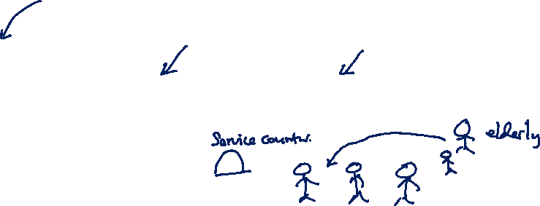
Foundation, Focus, and Future values
Foundation values:
The values we need in place to have a solid foundation to our lives
If our foundation values are threatened or if we are stressed, satisfying these values will demand most of our energy, pulling us away from our focus and future values.
Who are habitually very stressed may live out much of their lives in this area.

Slide 5
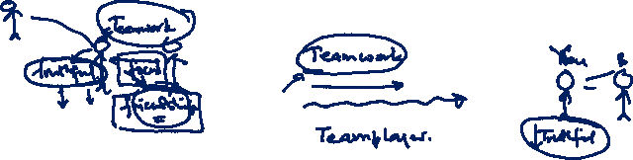
Foundation, Focus, and Future values
Focus values:
These are those value priorities in our lives that describe,
our present world view,
our criteria for decision making,
our attitude toward relationships, and
the focus of most of our energy.
We therefore tend to be more aware of our focus values than we are of our foundation or future values.

Slide 6
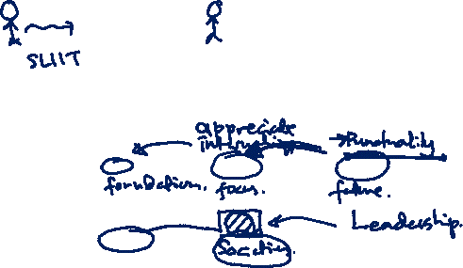
Foundation, Focus, and Future values
Future values:
These represent what is important to us about the future we are moving into.
Because they are not yet fully developed, but at the same time are important to us, they motivate us to grow and develop – pulling us into the future every moment of our lives.

Slide 7
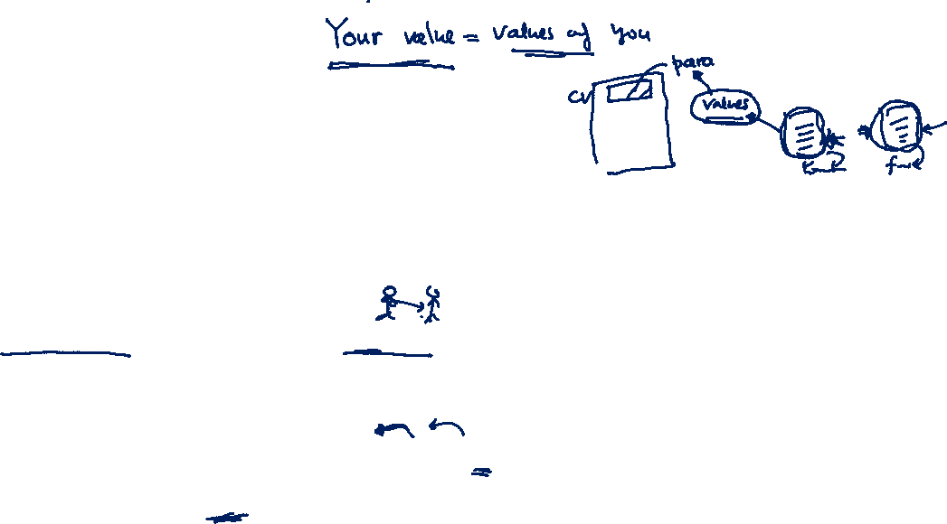
Value of values
! When we practice, actualize or embody our priority values, we experience our lives as meaningful, significant and important.
! Values help us understand why we believe what we believe – and, if we wish, to change it.
! Shared values are the basis of relationship – the better we understand our own and others’ values, the more likely we are to have meaningful and fulfilling relationships.
! If we value something, we will go after it – we will be motivated by it. Thus, if we
understand our values, we also know what motivates us.
! Knowing our own values makes us more tolerant of others’ values – and of them as people – and so leads us to appreciate diversity.

Slide 8
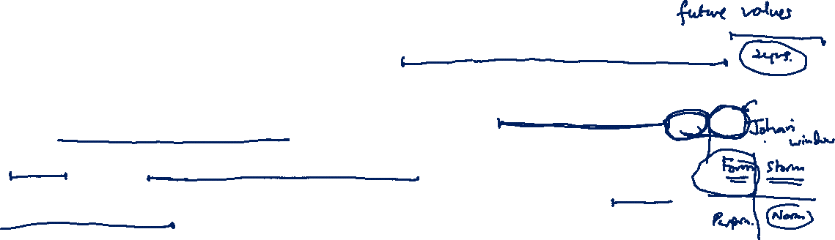
Value of values
! Being aware of our values helps us answer some of the big coaching questions such as ‘Who am I?’ and ‘What is the difference I want to make?’
! Discerning our future values enables us to act more intentionally and move smoothly into future phases of our lives.
! Knowing our foundation values helps us deal better with difficulty and stress and return to equilibrium more quickly.
! Teams that are unaware of their value priorities will tend to operate at the lowest common denominator world view; self aware teams can operate at the highest common denominator

Slide 9
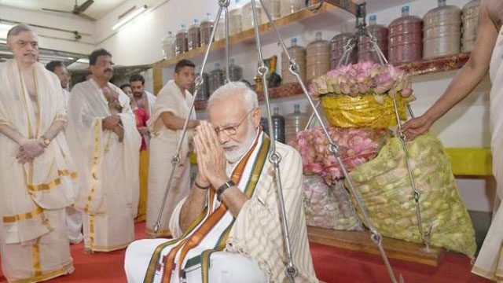
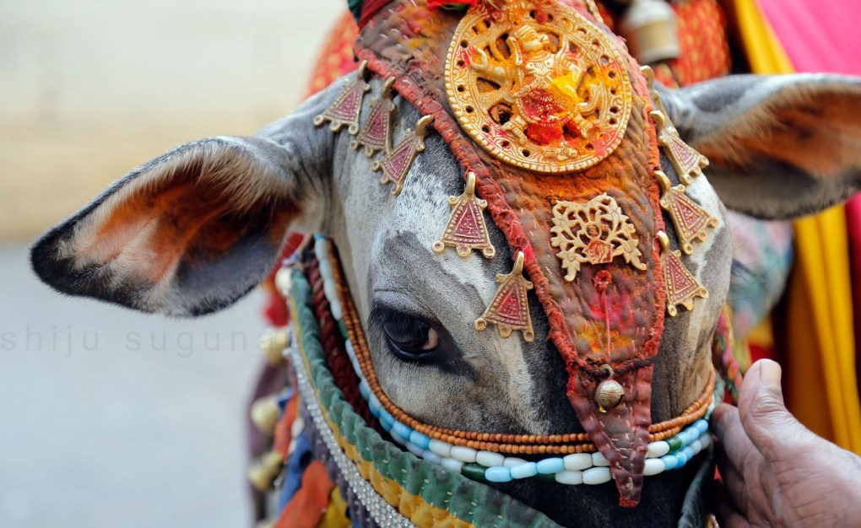
Beliefs

Slide 10

Beliefs
“Beliefs are constructs that we hold to be true, especially one without proof”
“Belief is the state of mind in which a person thinks something to be the case with or without there being empirical evidence to prove that something is the case with factual certainty”
-Wikipedia

Slide 11
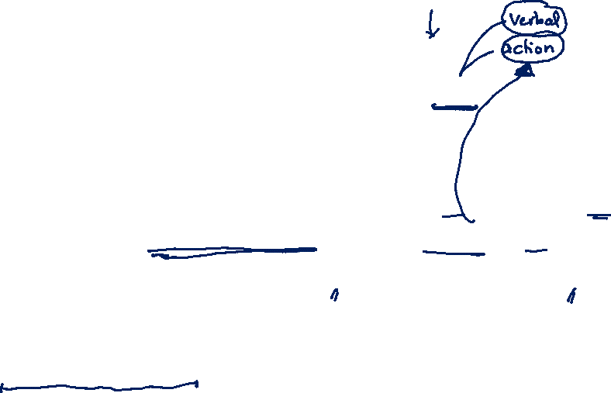
Attitude
Attitude is a mindset or a tendency to act in a particular way due to both an individual’s experience and temperament.
An attitude includes three components: an affect (a feeling), cognition (a thought or belief), and behavior (an action).
Although the feeling and belief components of attitudes are internal to a person, we can view a person’s attitude from his or her resulting behavior.

Slide 12
Attitude
Attitudes may simply be an enduring evaluation of a person or object (e.g., “I like John best of my coworkers”), or
An emotional reactions to objects and to people (e.g., “I dislike bossy people” or “Jane makes me angry”).
Attitudes also provide us with internal cognitions or beliefs and thoughts about people and objects (e.g., “Jane should work harder” or “Sam does not like working in this department”).
Attitudes cause us to behave in a particular way toward an object or person (e.g., “I write clearly in patients’ charts because it upsets me when I can’t read someone else’s handwriting”).

Slide 13
Attitude
Positive Attitude | Negative Attitude
Individuals who have a positive attitude will pay attention to the good, rather than bad in people, situations, events, etc. | People with a negative attitude ignore the good and pay attention to the bad in people, situations, events, etc.
Positive attitudes are rewarded. It means the individual is encouraged to do the same thing in future. | Negative attitudes are punished in order to discourage the same action in future.
If we think positive thoughts we will surely experience such emotions as joy, love, gratitude, peace, and hope. | If we think negative thoughts we will definitely have negative feelings such as anger, disappointment, irritation, envy, etc.
Having a “positive attitude” means a person believes everything happens for the best in the end. | A person with a “negatives attitude” tends to believe their best days are in the past. There is nothing to “look forward to” and considers it a waste of time and energy.

Slide 14
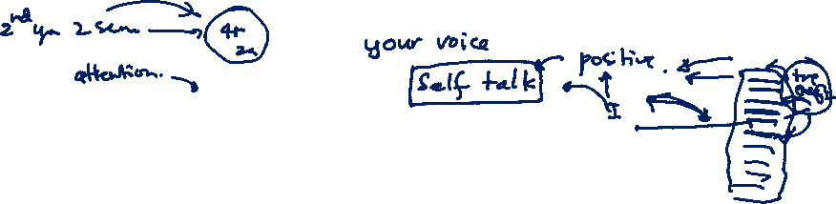
Attitude
Positive Attitude | Negative Attitude
It is an optimistic approach of a person to achieve good results. | It is a pessimistic mindset of a person who is not capable of handling critical issues.
It can achieve long-term goals easily and in time | It can achieve some initial goals but not the long-term goals
It is a process of solving problems. | It is a process of looking for problems.
A person with a positive attitude pays attention to the virtues of others. | A person with a negative attitude pays attention to other people’s shortcomings.
These persons always see opportunities. | These persons see only limitations.

Slide 15
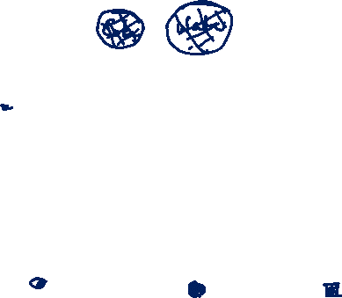
Character
Group of qualities that make a person, group or thing different from others.
What is “good character?” One definition is
1. “knowing the good, desiring the good and doing the good”; i.e., the head, the heart, the hand.
2. “understanding, caring about and acting on core ethical values such as honesty, responsibility, respect, hard work and caring for others.”

Slide 16

How Character develops
Your values shape your beliefs
Your beliefs shape your attitudes
Your attitudes shape your behaviors/actions.
Your behaviors/actions shape your habits
Your habits shape your character
Your character shapes your destiny

Slide 17
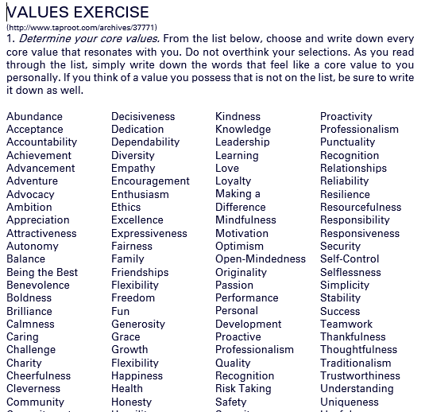
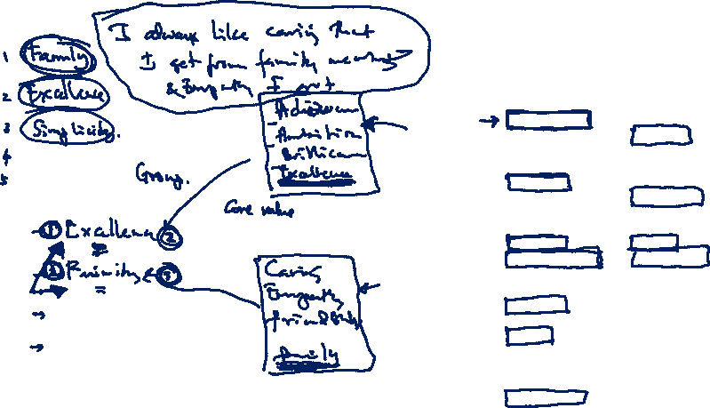
Values Exercise

Slide 18
Values exercise
STEP 1: Start with a Beginner’s Mind
STEP 2: Create Your List of Personal Values
STEP 3: Chunk Your Personal Values into Related Groups
STEP 4: Highlight the Central Theme of Each Value Group
STEP 5: Determine Your Top Personal Core Values
STEP 6: Give Your Personal Values Richer Context
STEP 7: Test the Ecology of Each Value

Slide 19
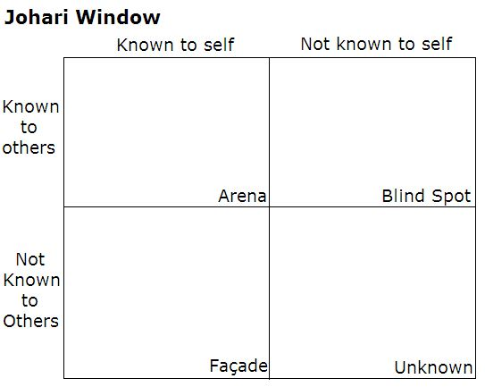
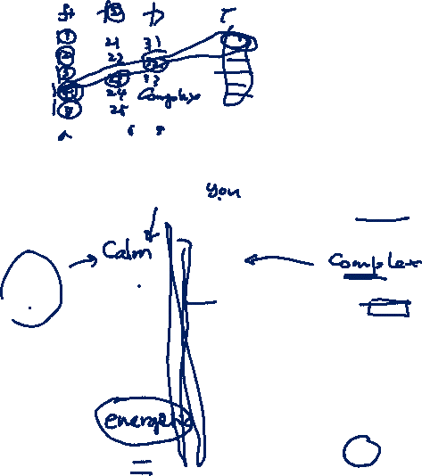
Johari window exercise
Johari Window: A graphic model of awareness in interpersonal relations
Developed by Joseph Luft (1916–2014) and Harrington Ingham (1916–1995) in 1955

Slide 20
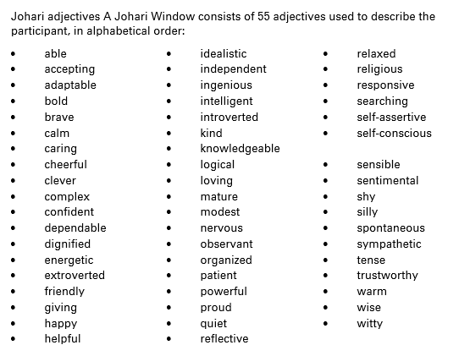
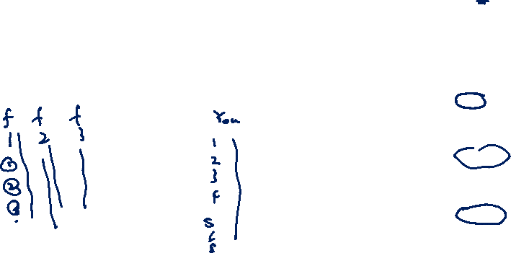
Johari Window

Slide 21
Concluding remarks
Knowing values, beliefs and attitudes helps us to develop a compelling character, to live a remarkable professional life
Industry always emphasize, “We hire individuals with good values and attitudes, because with those qualities, developing their technical skills is a simple task”
Know thyself – Socrates
Knowing yourself is the beginning of all wisdom – Aristotal

Slide 22

Exercise
- Write “About Me” paragraph to a CV highlighting your core values. This may contain 5-6 Sentences (60~75 words).
- Complete Johari window exercise by getting feedback from your parents, friends, teammates, teachers
- Write a reflective journal on an incident/situation in real life that you faced where content discussed in this lecture will be useful/can be put into practice
- Submit your assignment on or before midnight 03rd August, 2021

